Slide 1
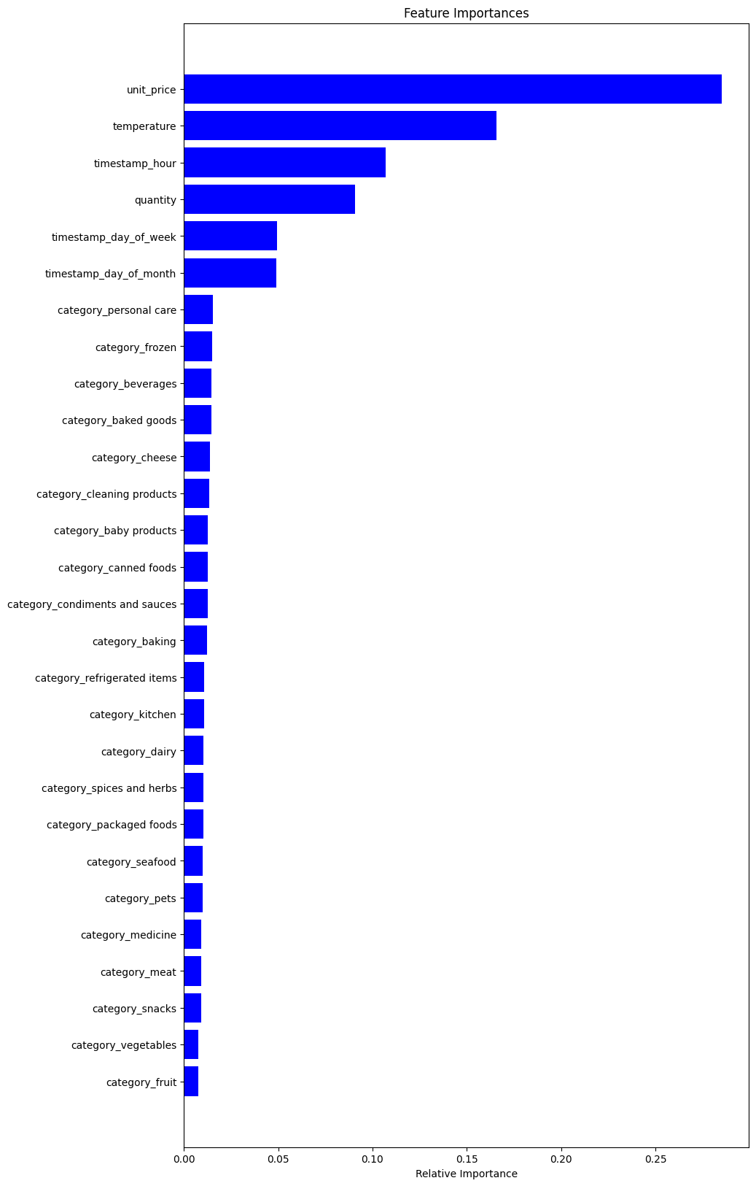
Objective Achieved: Developed a predictive model to estimate stock levels on an hourly basis.
Key Data Utilized: Combined sales and sensor data, including temperature and time-based features, to predict stock levels.
Model Consistency: Achieved a stable average Mean Absolute Error of 0.24 across different validation sets, indicating reliable performance.
Influential Predictors: The model identified unit_price, temperature, and timestamp_hour as top influencers on stock levels, guiding focused inventory control.
Business Impact:
Strategic Restocking: Enables proactive restocking, reducing the risk of over/under stocking by approximately 24%.
Operational Efficiency: Informs intelligent procurement with sensor integration, optimizing inventory turnover.
Enhanced Decision Making: Provides hourly actionable insights to maintain optimal stock levels and improve customer satisfaction.
This model provides a strategic tool for precise inventory management, leading to cost savings and enhanced customer experience.

